Slide 1
Modularized Robotic Arm
Team 15
Functional Specification Requirements
Fuhua Song
Kevin Bradshaw
Zhengshuai Zhang
Yuan Tian

Slide 2
Overview
Modularized Robotic Arm
Functional Systems
Power and Control Systems
Wireless System
Overall System Latency
Tools/Hand Control System
Mechanical Systems
ECEN 403 - Team 15

Slide 3
Power and Control Systems - Kevin
Robotic Arm Power Requirement: 1.5 Hours of Run time
Power Supply: 12V, 5 ah
Power Draw: 7.728 W
Life: 3 hours run time maximum
Raspberry Pi Power Requirement: 2 Hours of Run time
Power Supply: 5 V, 5 ah
Power Draw: 6 W
Life: 4 hours run time maximum
 | Shoulder Motor 1 | Shoulder Motor 2 | Elbow Motor | Wrist Motor 1 | Wrist Motor 2
Current Drain | 700 mA | 350 mA | 230 mA | 180 mA | 150 mA
Power | 3.36 W | 1.68 W | 1.104 W | 0.864 W | 0.72 W
ECEN 403 - Team 15
3

Slide 4
Wireless System, Raspberry Pi 2 - Fuhua
Wireless Capabilities
Code simplification to reduce time from MCU
10+ meter range for prototype phase
Raspberry pi 2 platform feeding information at 2.4 Ghz wifi
RF module sending 433Mhz from button to control of the tools
Raspberry pi send and receive information from laptop as central port
Raspberry pi 2
Maximum Specification: 900 MHz CPU / 1GB RAM
Raspberry Pi 2 | Module | Used RAM
First Module | Temperature/Haptic Fieldback | <50MB
Second Module | 2 Video System | 150MB
ECEN 403 - Team 15
Notes:
Raspberry pi 900 MHz Camera module:RPI_5MCAMWD_LR2

Slide 5
Latency Minimization- Yuan
Kinect Servo Motor
ourframe.SkeletonData[i].SkeletonPositions[NUI_SKELETON_POSITION_HAND_RIGHT].x
X,Y,Z coordinate value of 3D map over human joints (“Double” type Size: 8 bytes)
Numerical Value Ranging from -0.8 to +0.8 (6 feet away from Kinect)
Coordinate data is processed by a specific algorithm, then is sent to PWM on raspberry Pi 2, which will generate pulses to drive the motor. Algorithm calculation is done by PC which has very high CPU Clk frequency so that the processing time can be neglected.
Generally,the default PWM frequency is set to be 19.2 MHz (prescale function: pwmClock() ). 100% duty cycle is uniformly distributed over 180 degree. 1.8 degree/ 1 percent of increasing duty cycle cycle.
Based on calculation, the minimum latency from Kinect to PWM on Raspberry Pi 2 is 0.033s. The highest theoretical Servo motor rotation speed is 3.456E9 degrees / sec, which results in a smallest theoretical servo motor action window of 5.2E-8 sec. The lowest theoretical Servo motor rotation speed is 9000 degrees / sec, which results in a largest theoretical servo motor action window of 0.02 sec. Theoretical Latency: 0.053 s ~0.033 s
Balance torque and rotation speed of servo motor
ECEN 403 - Team 15

Slide 6
Tools/Hand Controls - Zhengshuai
Sensors’ Requirements
Functions and capabilities
Function: medical surgery assistances
Capability: gripping,cutting, stitching
Sensor data:
Force sensors:
Force required to pierce skin: 100 psi = 68.95 N/(cm^2)
Infrared Temperature sensor incorporated
Wireless
Haptic feedback
Temperature feedback
Video feedback
 | Force sensor | Temperature sensor
voltage | 1V(input) | 2.2 ~ 3.6 V (supply)
current | 2.5mA (max) | 240 uA (max)
ECEN 403 - Team 15

Slide 7
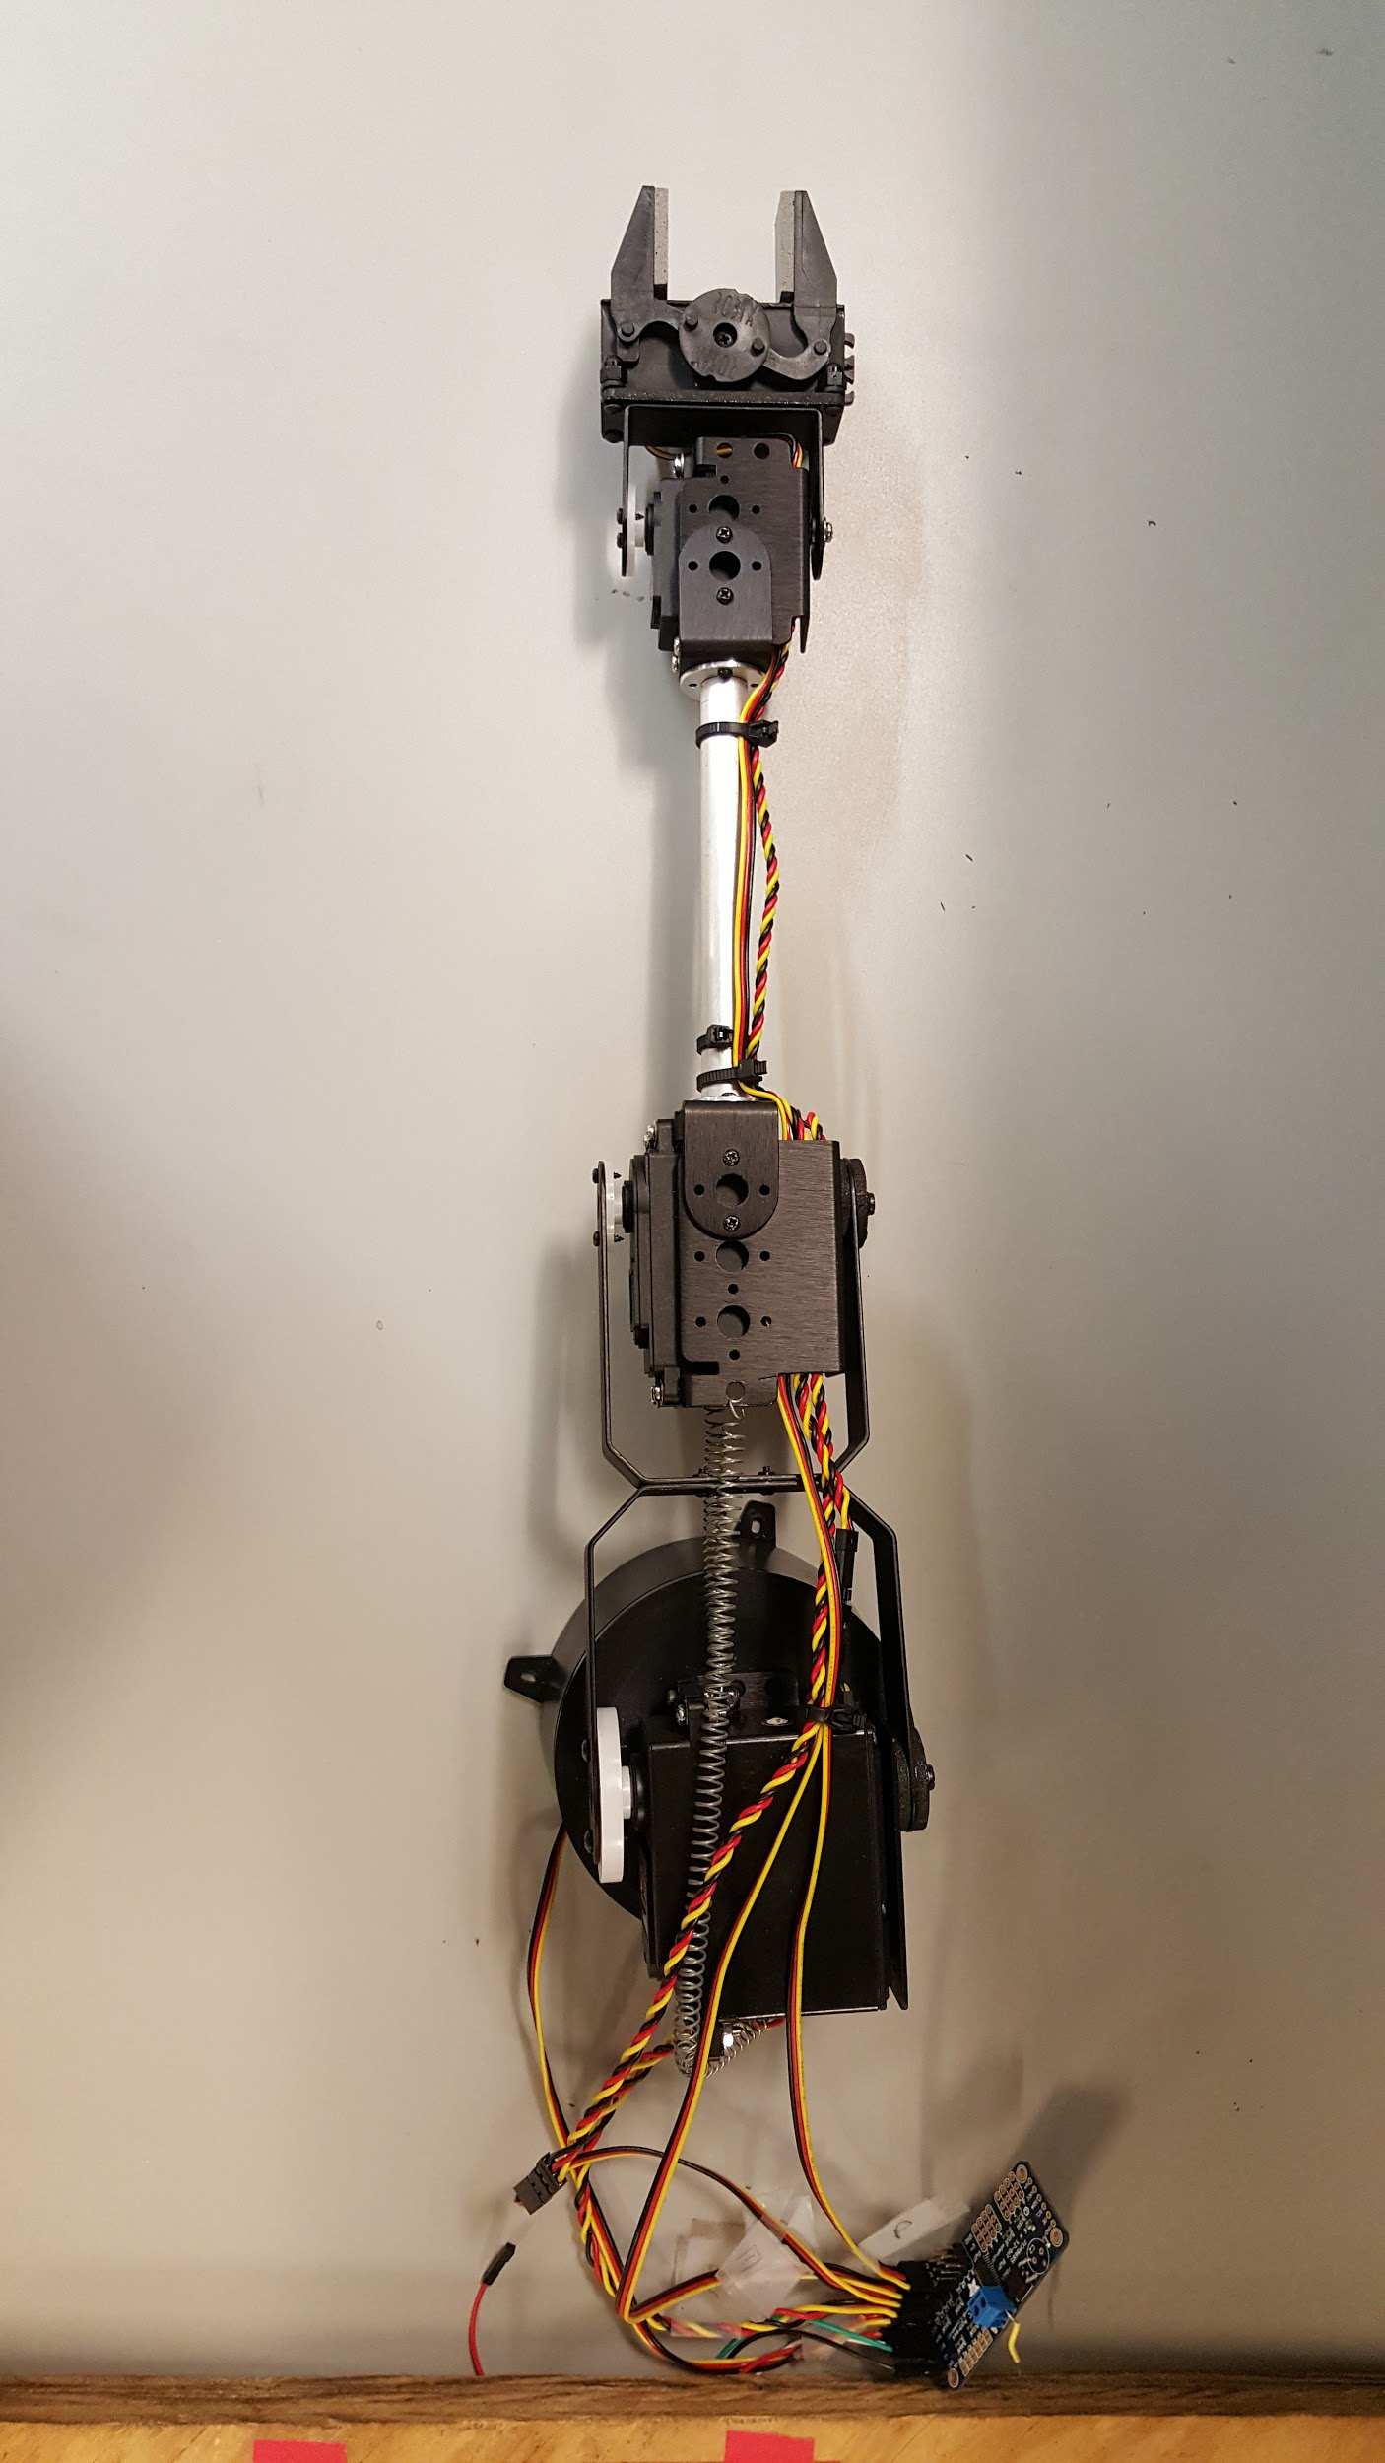
Mechanical Systems - Kevin
Holding Weight Requirement: 2.25 pounds
Shoulder Motor 1 Torque: 274.96 oz.in. = 1.432 ft. lbs
Shoulder Motor 2 Torque: 152.75 oz.in. = 0.796 ft. lbs
Elbow Motor Torque: 106.90 oz.in. = 0.556 ft. lbs
Wrist Motor 1 Torque: 66.6 oz.in. = 0.347 ft. lbs
Wrist Motor 2 Torque: 45.82 oz.in. = 0.239 ft. Lbs
Current Weight: ~1.6 lbs.
Possible 7 inch modification extension
ECEN 403 - Team 15

Slide 8
Conclusion
The Robotic Arm Kit system is optimized for usage in the medical field. The various subsystems enables the system to perform accurate operations wirelessly with minimum latency.
ECEN 403 - Team 15

Slide 9
Questions?

